Slide 1
DETECTION OF PNEUMONIA USING CONVOLUTIONAL NEURAL NETWORK AND DEEP LEARNING
VARISI ANUHYA(21331A05I1)
PAMU CHANDU (21331A05D7)
GRANDHI SAI HEMANTH KUMAR (21331A0557)
Under the supervision of
Dr. Mohammad Farukh Hashmi
Assistant Professor
NIT Warangal

Slide 2
ABSTRACT
To investigate the prospects, uses, and technology of the detection of pneumonia using convolutional neural networks and deep learning, this study provides a thorough review. This work uses a synthetic approach to select relevant research sources. This In addition to offering an updated model for detecting pneumonia, which will be used in our upcoming research, the paper surveys and compares the detection of lung disease using several computer-aided techniques. In the study, the most popular datasets, including Google Scholar, were searched. Approximately thirty publications were collected, of which fifteen underwent in-depth examination based on the topic of interest. Additionally, the review paper emphasizes the significance of COVID-19, pneumonia, tuberculosis, and normal. Humans can contract pneumonia, a potentially fatal bacterial disease that primarily affects one or both lungs and is brought on by the bacteria Streptococcus pneumoniae.

Slide 3
INTRODUCTION
Indoor air pollution is one of the main causes of pneumonia in children. Pneumonia is a severe acute respiratory illness that affects many people in age groups at extreme of the average human lifespan. It is caused by infectious organisms with high attack rates. In the US alone, pneumonia causes over a million adult hospital admissions and almost 50,000 deaths each year. Doctors diagnose pneumonia in hospital patients in a number of ways, including physical examination, medical history, clinical investigations (such as sputum or blood tests), chest X-rays, and several other imaging techniques. William Osler referred to pneumonia as "the captain of the men of death" in the 1800s.
Computer-aided designs (CAD) have emerged as the key area of machine learning research in recent years. CAD can lessen workload pressure, increase inter- and intra-reader variability, and enhance diagnostic accuracy . Inspired by the brain's visual cortex, convolutional neural networks (CNNs) are utilized to handle challenging image-driven pattern recognition problems by identifying both linear and nonlinear patterns. Convolutional Neural Networks (CNNs), in particular, have demonstrated their self-potential to extract valuable features in image classification tasks when used as Deep Learning (DL) models.

Slide 4
LITERATURE SURVEY
The challenge of classifying chest x-ray pictures into different classes has been considerably explored in the realm of medical diagnosis. Researchers have attempted to apply several methods for decreasing dimensionality in. The artificial neural network was tested by the authors in to detect lung disorders, such as tuberculosis, pneumonia, and lung cancer. Recently, there has been an increase in interest in the field of medical picture classification for the investigation of machine learning (ML) algorithms for the detection of thoracic disorders. A technique for identifying pulmonary tuberculosis was presented by Lakhani and Sundaram (2017), based on the architecture of two distinct CNNs, AlexNet and Google Net. To detect pneumonia at a level that is superior to that of radiologists, Pranav Rajpurkar, Jeremy Irvin, et al. (2017) recently investigated this dataset. They called their model Chex Net, and it employs DenseNet-121layer architecture to detect all 14 diseases from the large number of 112,200 images that are available in the dataset.

Slide 5
METHODS
A class of deep neural networks called convolutional neural networks (CNN) is used to analyse visual imagery. It is made up of numerous hidden layers, an input layer, and an output layer. A CNN-based machine learning system was used to classify the images. One type of deep learning neural network is the CNN. In our CNN model, we employed ten layers in total: two dense layers, a flatten layer, a dropout layer, three MaxPooling2D layers, and three Convolution2D layers.
Fig-1: CNN Sample Architecture

Slide 6
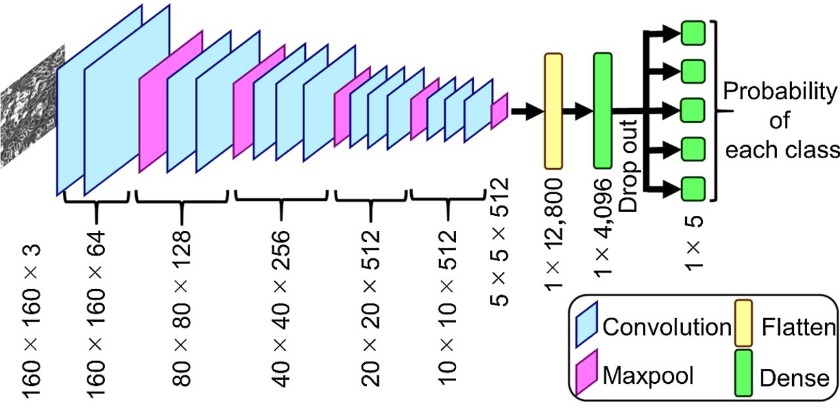
Fig-2: CNN Model Architecture

Slide 7
MATERIALS
The combination of the Covid19 chest x-ray, tuberculosis, and pneumonia datasets is the dataset that we used. The datasets we downloaded from Kaggle include Chest X-ray Images (Pneumonia) [34], Chest X-ray (Covid-19 & Pneumonia), Curated COVID-19 Chest X-Ray Dataset, and Tuberculosis (TB) Chest X-ray Cleaned Database.
The base folders are named Test, Train, and Valid, while the subfolders of each folder are named Covid19, Normal, Pneumonia, and Tuberculosis. Chest x-ray images are classified (Categorical data) and placed separately in Covid19, Normal, Pneumonia, Tuberculosis sub folders of Test, Train, Valid.
Category Training Set Validation Set Testing Set
Normal 2650 654 234 Pneumonia 8917 861 411 Covid19 1025 256 116 Tuberculosis 2650 150 700
Total 15242 1921 1461 Percentage 82 10 8
Table-1: Description of the experimental dataset.

Slide 8
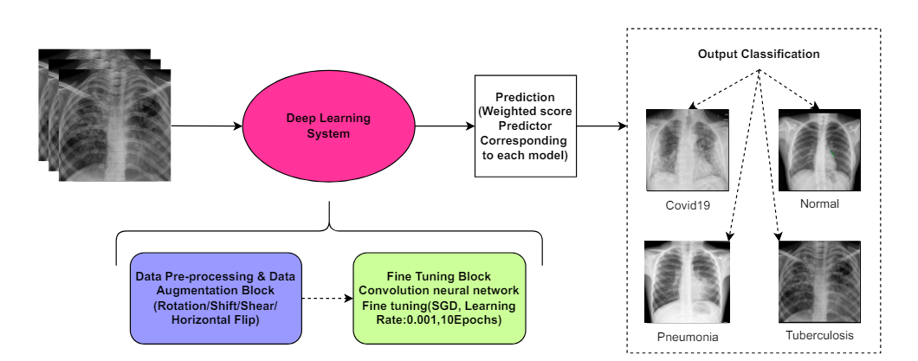
PROPOSED METHODOLOGY
Fig-3: Block diagram of the proposed methodology
Resizing the X-ray images was a crucial step in the data preprocessing process because different algorithms required varied image input sizes. We set the model's input size to 224,224,3, where 224,224 is the image form and 3 is the number of channels (R, G, and B). Thus, we changed the form of our input image to 224,224.
Data augmentation makes better use of already-existing data to address this issue. It helps make the current training dataset larger and prevents the model from overfitting this dataset.

Slide 9
EXPERIMENTAL SETUP
Parameters | Values
Number of Classes | 4
Image Size | (224,224)
Channels | 3
Batch Size | 256
Epochs | 20
Optimizer | Adamax
Learning Rate | 0.001
Activation Function | Sigmoid, relu
Loss Function | categorical_crossentropy
Table-2: Experimental setup of CNN model
This section presents the experiments and assessment methods utilized in the research to assess the suggested model's efficacy. Utilized was the chest X-ray image collection that was suggested in. The pre-trained architectures were loaded onto the ImageNet Dataset using the open-source Keras deep learning framework, which was then tuned for the given job using TensorFlow as the backend. A standard PC equipped with an Intel i7 seventh-generation CPU, 8 GB RAM, and an NVIDIA GeForce GTX 1060 6 GB GPU handled all of the processing work.

Slide 10
EXPERIMENT RESULTS AND DISCUSSION
 | Accuracy | Loss
Training | 99.9% | 0.001
Validation | 97.7% | 0.093
Testing | 98.2% | 0.071
Table-3: Model Evaluation
99.9% of the training data are correctly classified by the model during the training phase. A loss of 0.001, which is incredibly low, shows how well the model has absorbed the training set.
The validation stage's accuracy of 97.7% shows how well the model performs on the validation set, which is used to fine-tune the model. Although 97.7% accuracy is high, it is less than the training accuracy, suggesting a minor decline in performance and we got loss of 0.093 which means it performed well.
The model's performance on the test set is represented by its accuracy of 98.2% in the testing state, which is used to evaluate the final model. Furthermore impressive is the accuracy of 98.2%, which shows how effectively the model generalizes to fresh, untested data. An excellent sign of generalization is the test set loss of 0.071, which is larger than the training loss but lower than the validation loss.

Slide 11
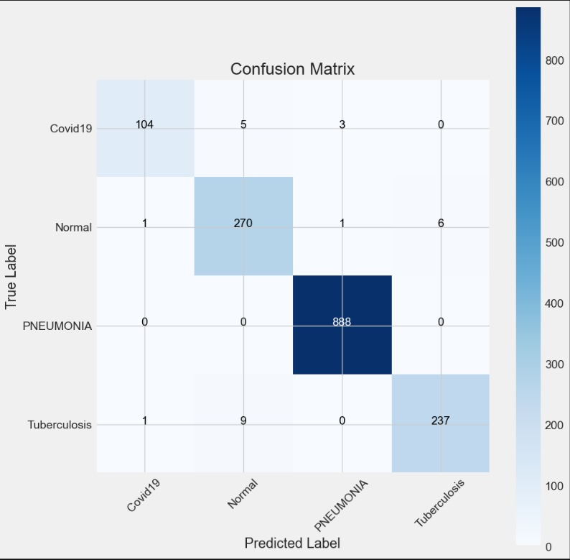
Fig-3: Confusion Matrix
True positive (TP) indicates the number of pneumonia images identified as pneumonia, true negative (TN) indicates the number of normal images identified as normal (healthy), false positive (FP) indicates the number of normal images incorrectly identified as pneumonia images, and false negative (FN) indicates the number of pneumonia images incorrectly identified as normal. These definitions and equations are used to classify patients into healthy and pneumonia patients.

Slide 12
 | Precision | Recall | f1-score | Support
Covid19 | 0.98 | 0.93 | 0.95 | 112
Normal | 0.95 | 0.97 | 0.96 | 278
Pneumonia | 1.00 | 1.00 | 1.00 | 888
Tuberculosis | 0.98 | 0.96 | 0.97 | 247
Table-4: Classification Report
According to classification report we can observe that:
With 112 cases, "Covid19" has a f1-score of 0.95, recall of 0.93, and precision of 0.98.
With 278 instances, "normal" has a f1-score of 0.96, recall of 0.97, and precision of 0.95.
With 888 instances, "pneumonia" has a f1-score of 1.00, precision and recall of 1.00.
With 247 instances, "tuberculosis" has a f1-score of 0.97, recall of 0.96, and precision of 0.98.

Slide 13
CONCLUSION
In this paper, we attempt to find a simpler approach for pneumonia detection for chest X-ray images by comparing the different architectures on the same dataset. Based on our findings, we selected the most perfect model, which is easy to train and has one of the best performance metrics. There are several approaches to detecting pneumonia using CNN, and it gives better accuracy, recall, and F1 score. We are using deep learning algorithms that have proven to be more realistic. It can also be observed that the accuracy of the network can be increased by preprocessing techniques. CNN model to provide efficient accuracy and best solution for the pneumonia detection based on the chest X-ray images.
For the first, we got less validation accuracy and less training accuracy, so we trained this model again and again. After training the CNN model, we got a validation accuracy of 97% and a training accuracy of 99%.

Slide 14
THANK YOU

